Slide 1
Cook County Health Survey
Alfreda Holloway-Beth, PhD, MS
Director of Epidemiology
June 13, 2022

Slide 2
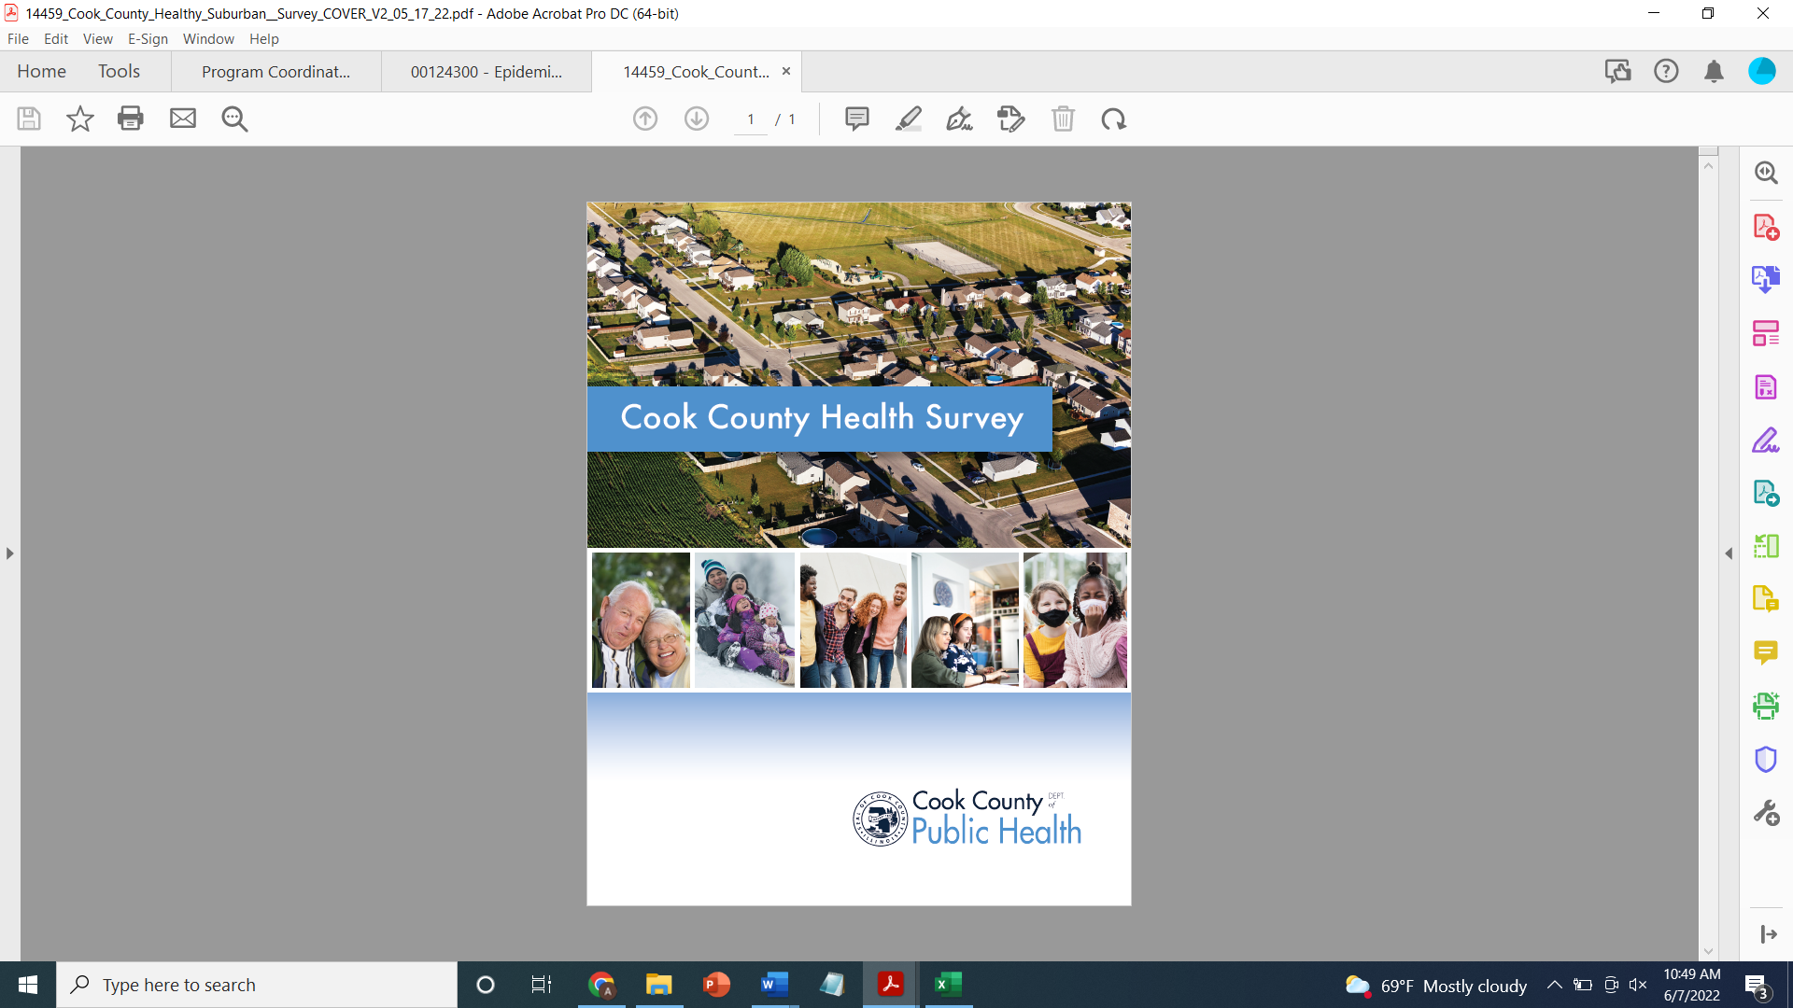
National Initiative to Address CoVID-19 Health Disparities Among Populations at High-Risk and Underserved, including Racial and Ethnic Minority Populations and Rural Communities (CDC-OT21-2103)
Activity 2.3
Purpose: To take a health equity approach to public health in order to increase the availability, accessibility and understanding of health behavior and outcomes data by age, gender, and race & ethnicity.
Problem Statement: Traditional public health data on births, causes of deaths, behavioral risks and various diseases collected by existing methods are limited and do not do enough to support CCDPH and our communities in understanding local health concerns and the community, social and structural factors associated with health. Data are scattered, incomplete, or lack granularity to target action where, when and for whom it is needed, and are sometimes not gathered consistently that allows trends to be analyzed.
Current Projects: CCDPH is conducting two population health surveys to provide statistically reliable data, ensure data visualization, and access to data that resonates with CCDPH staff, partner organizations, and the public, regardless of data science background. The hope is that these data can help to inform policies, programs and activities. This presentation is focuses on the Cook County Health Survey (CCHS).

Slide 3
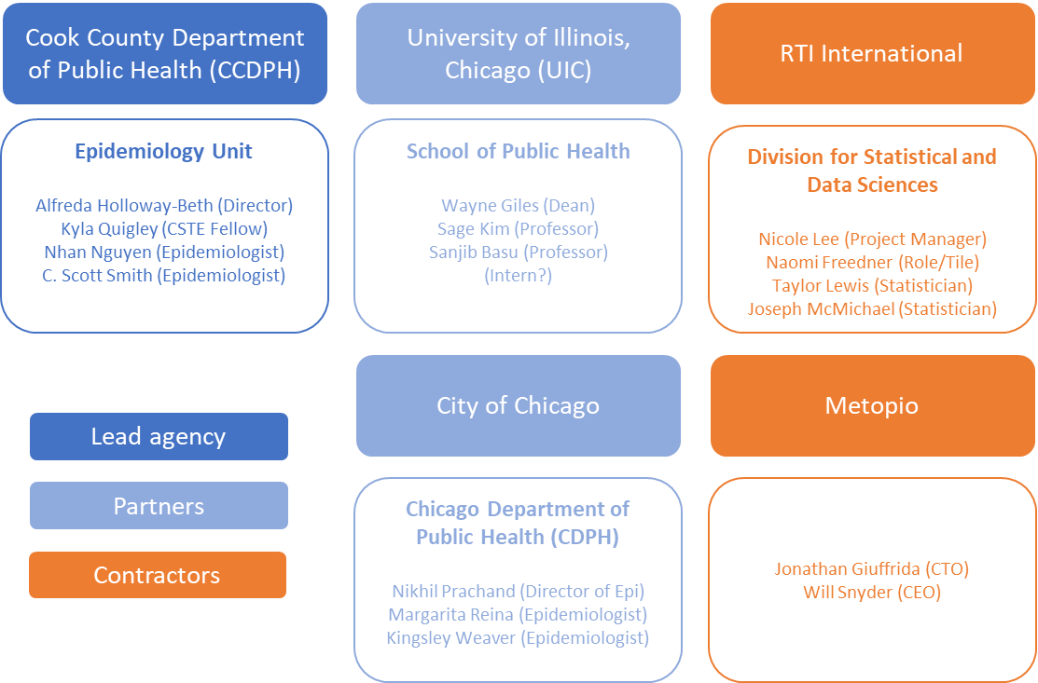

Slide 4
The Cook County Department of Public Health (CCDPH) is conducting the Cook County Health Survey. Starting with the framework developed and implemented by the Chicago Department of Public Health’s (CDPH) Healthy Chicago Survey (HCS) that began in 2014. The Cook County Health Survey (CCHS) is a multi-modal data collection survey for which information from a random sample of adult suburban Cook residents, including demographics and social characteristics, health status, risk behaviors, and access to health care. For the 2022 survey, CCDPH is targeting 8,000 completed surveys in order to provide municipal-level, demographic subgroup, and geographic subgroup information that will be used to inform and monitor the health status of our communities. The CCHS data will be used to provide health, exposure, and health behavior indicator data to help identify where health disparities existing suburban Cook County which will inform policy, program development, community health education initiatives, and public awareness campaigns to address them.
The CCHS is an annual survey that was launched in 2022 by the CCDPH to better understand the health of suburban Cook County residents.
Notes:
Q: What is this survey about?
A: The Cook County Health Survey is being conducted by the Cook County Department of Public Health (CCDPH) to collect information about the health of County residents.
Q: Why was I contacted/selected? Why did I receive a letter/postcard?
A: Your address was selected using an address-based sampling (ABS) method in Cook County. By participating in the survey, you are representing your community.
Q: What kinds of questions do you ask?
A: The survey asks questions about various aspects of your health and your community, including physical and mental health, health conditions, health behaviors (such as physical activity or fruit and vegetable consumption), access to healthcare, health insurance, COVID-19, and neighborhood safety.
Q: Are my responses going to be confidential? What will you do with my information?
A: Your answers to the survey are all completely confidential. At the conclusion of the study, survey responses will be combined and analyzed at the aggregate level, which means that no one person’s answers will be reported. The Cook County Department of Public Health will not sell your information. RTI International, who is conducting the survey on behalf of the Department of Public Health, will only use contact information for contacting you to complete the survey and for sending your incentive. Contact information will be kept separate from survey responses.
Q: How long is this survey? A: On average, the survey takes approximately 25 – 30 minutes. The survey does not need to be completed in a single sitting. You may answer a few questions at a time over several days, at your own convenience.
Q: How will you use this information? A: Data collected from the Cook County Health Survey are used to help the Cook County Department of Public Health assess the health-related needs of the county population and to guide the Department in planning programs to improve the health and wellbeing of county residents.
Q: I’m in good health. Do I have to participate in this survey?
A: The Cook County Department of Public Health wants to include a diverse representation of residents in the County, including people in good and poor health, as well as people who represent a variety of backgrounds across race, ethnicity, gender, age, insurance status, and employment status.
Q: What if multiple people live in my household? Can more than one person participate?
A: We only need the survey completed by one person from each household. The survey should be completed by the member of your household age 18 or over with the most recent birthday.
Q: Can I volunteer to participate? Can someone I know participate in the study?
A: We appreciate interest in volunteering to take the survey, but unfortunately only people who have been contacted by RTI International on behalf of the Cook County Department of Public Health are invited to participate in the survey. If you receive a letter about the survey, your household is eligible to participate.

Slide 5
The 2022 CCHS is a cross-sectional survey with a sample of approximately 8000 randomly selected adults aged 18 and older suburban Cook County residents. Interviews are conducted in English and Spanish. All data collected are self-reported.
Information from the CCHS is used to:
Identify health concerns for suburban Cook County
Understand environmental, neighborhood and social factors associated with health
Support the implementation and development of public health interventions and policies to address health inequities
The CCHS collects information on a range of topics including access to health services, civic engagement, childhood experiences, chronic health conditions, COVID-19, diet, financial security, food security, mental health, neighborhood conditions, physical activity, and safety, substance use, violence.
If you receive a letter/postcard from CCDPH, you have been randomly selected to participate based on an address-based sampling (ABS) method in suburban Cook County. By participating in the survey, you are representing your community.

Slide 6
The survey is completely confidential. At the conclusion of the study, survey responses will be combined and analyzed at the aggregate level, which means that no one person’s answers will be reported. CCDPH will not sell your information. RTI International, who is conducting the survey on behalf of the Department of Public Health, will only use contact information for contacting you to complete the survey and for sending your incentive. Contact information will be kept separate from survey responses.
On average, the survey takes approximately 25 – 30 minutes. The survey does not need to be completed in a single sitting. You may answer a few questions at a time over several days, at your own convenience.
CCDPH wants to include a diverse representation of residents in suburban Cook County, including people in good and poor health, as well as people who represent a variety of backgrounds across race, ethnicity, gender, age, insurance status, and employment status.
Only one person aged 18 or over from each household should complete the survey.
Please note that volunteering to take the survey is not allowed and only those who have been invited to participate in the survey can complete the survey.

